Slide 1




Prediction Model of Electoral Results in Mexico:
A Case Study using PREP, INEGI and INE Data.
Data Science Intensive Capstone Project, August 3rd, 2024
By Javier Jorge Pérez Ontiveros
Mentor
Ale Berbesi

Slide 2
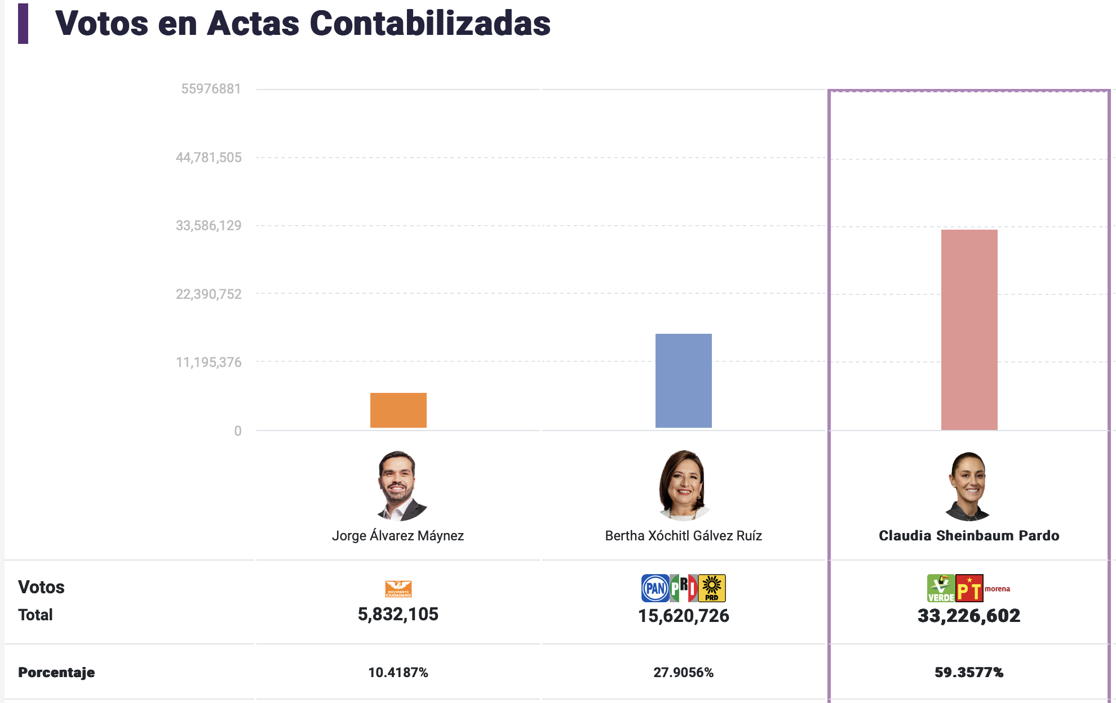
Executive Summary:
This project uses the PREP, INEGI and INE databases, this provides detailed data on previous elections, including voter demographics, polling station information, economic variables, etc.
Analyzing this data helps identify hidden patterns and trends, which can enhance campaign strategies, policymaking, and voter engagement efforts.
The goal is to understand why the winning party (MORENA) achieved a 59% acceptance rate, while the opposition (PAN-PRI-PRD) secured only 28% of the votes.
Objectives:
To generate a Model that predicts votes for MORENA
To provide actionable insights to support the Opposition Party in developing a strategy to improve their results in the 2030 elections.
Results:
Geographic heatmap and interesting insights
2 Main Voters Profiles were discovered with unsupervised learning (k-Means Clustering).
A final Machine Learning Model with 98% accuracy was developed.

Slide 3




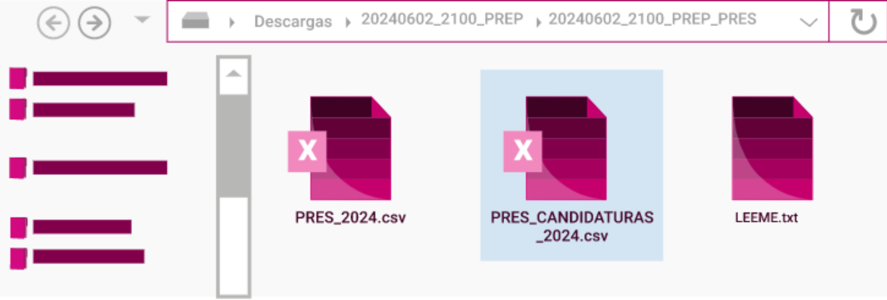
Methodology
Data Engineering
Data Wrangling
Exploratory Analysis (EDA) and Visualization
Feature Engineering and Clusterization
Predictive Modeling
Reporting

Slide 4
Data Sources
Data Engineering and Data Wrangling:
Acquiring, Cleaning and Merging
PREP
2024 and 2018 election results exported from database to CSV file.
55,976,881 votes
170,944 polling stations
1,580 municipalities
32 states
INEGI
Socioeconomic inputs for the 32 states in csv:
Hospitals, Schooling Years, vehicles purchased, catholic believers, murders per year, population ages, Poberty ratios, Average Income, etc.
INE
Performance and Behavior of Parties per state in csv:
# of Campaign events,
Marketing Budget,
Federal Welfare,

Slide 5
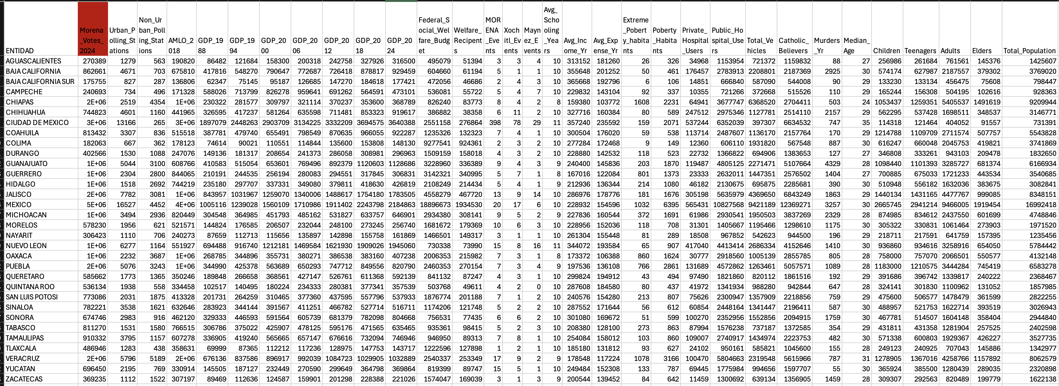
Final DataFrame
A 40 columns x 32 rows Dataframe was created to predict the votes for MORENA Entity
This Dataframe was further modified and expanded with the use of some ratios and feature engineering.

Slide 6
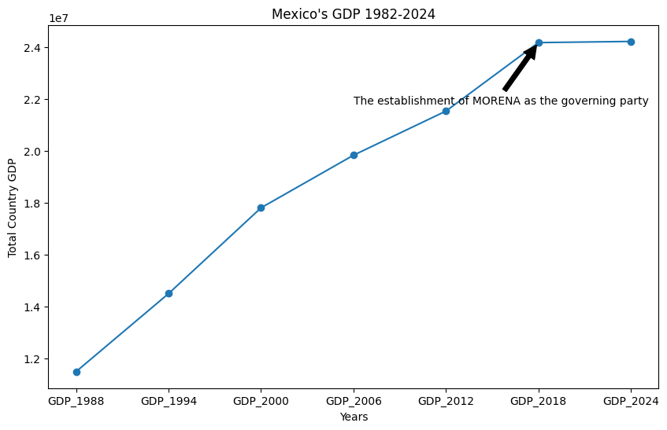
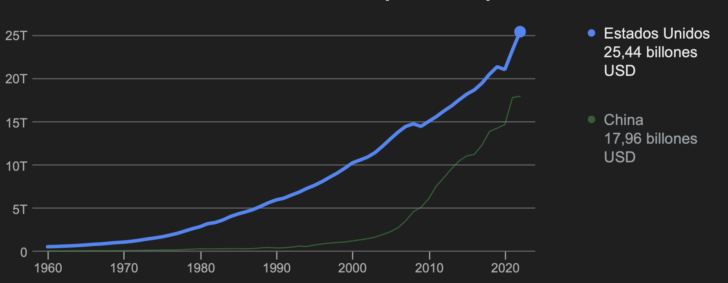
Insight #1: GDP has stagnated since 2018
Since AMLO president won elections in 2018, the economy in Mexico has slowed down.
In comparisson, USA and China have a very positive trend
(even after Covid)
In the other hand, with Opposition parties, From 1988-2018, the GDP had a 10%-20% growth in average
This is a Key argument that needs to be “Sold” to the mexicans to gain more votes.

Slide 7
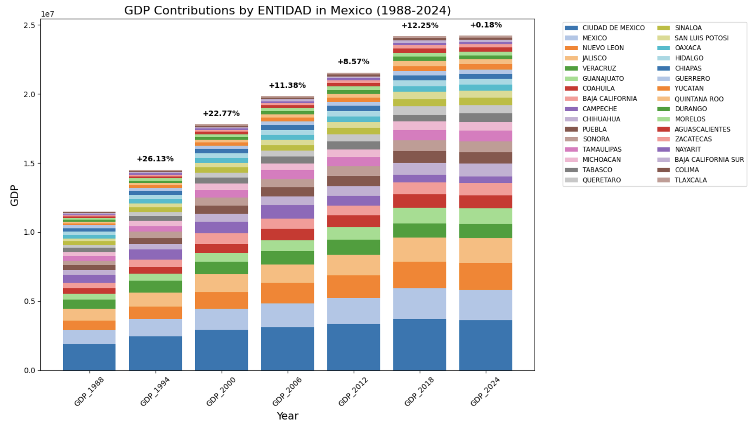
Crime Scene: Economy stagnation per State

Slide 8
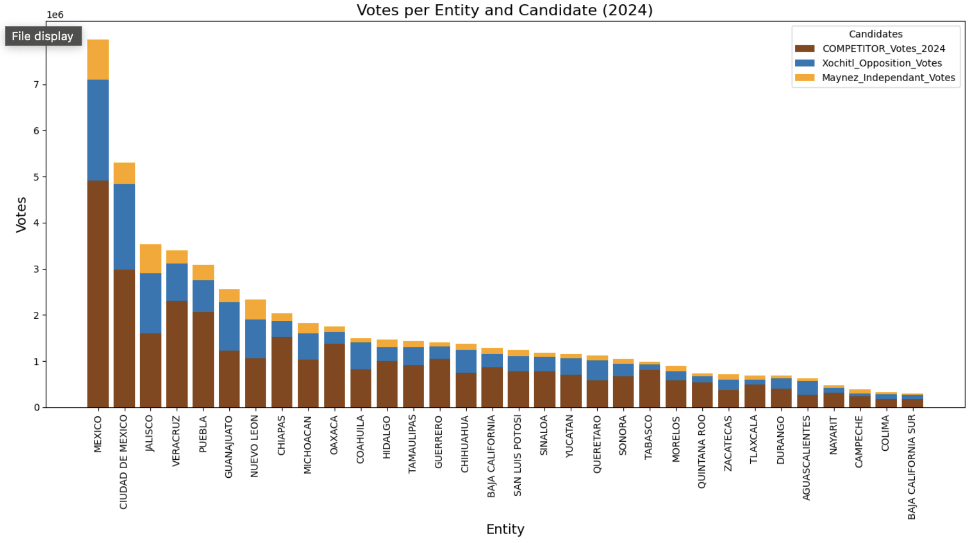
Votes per Entity

Slide 9
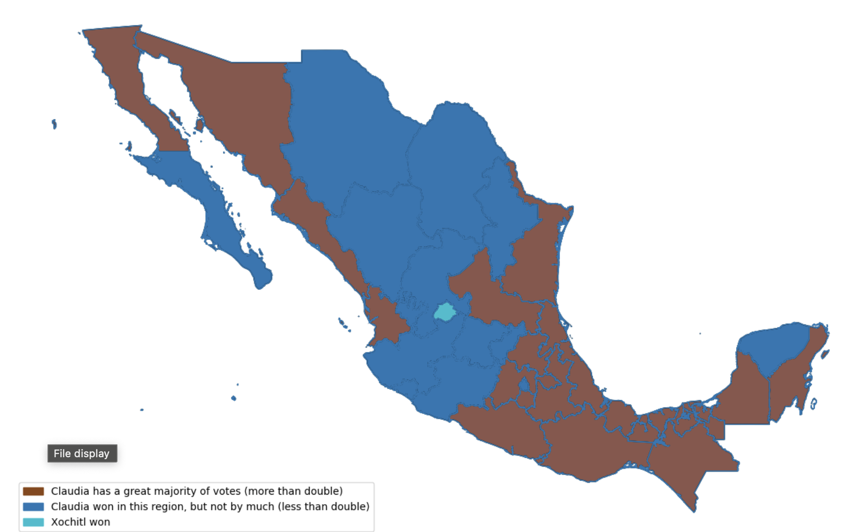
Geographical Heatmap Distribution
The map shows a significant trend where the highest resistance (blue color) is observed in the Bajío region, known for its industrial and economic strength. While the stronger MORENA states are in the South-East Region (Less Industiral and Economical development)
This is interesting as votes for MORENA, the competitor party, correlate highly with poverty ratios.
Opposition Party MUST focus on helping the less priviledged population from 2024-2030 if they want to have a chance of winning.

Slide 10
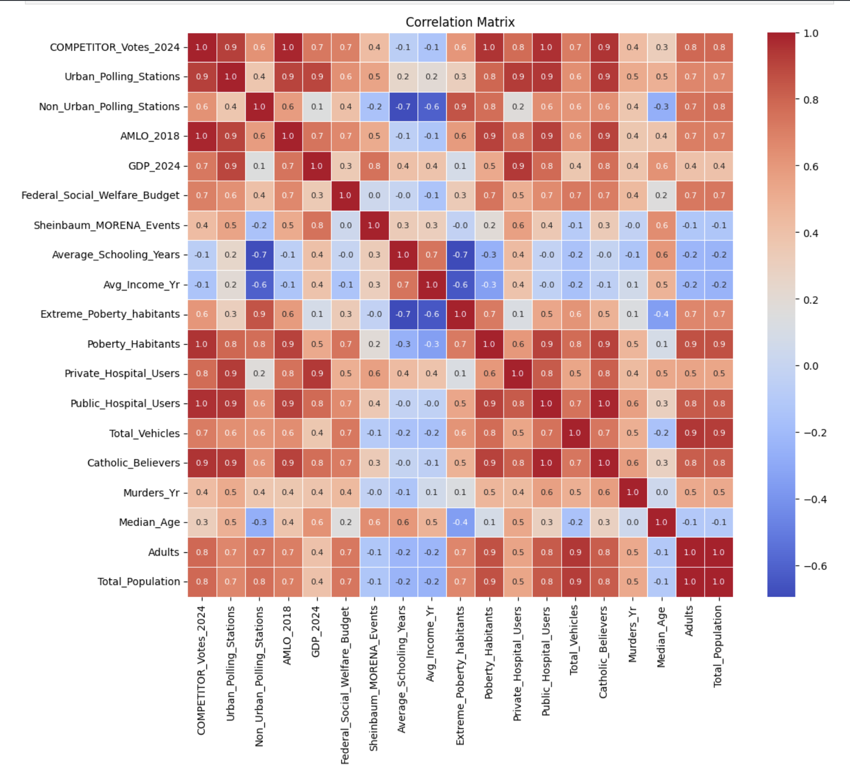
Features vs Response Heatmap
Since the begining of this study these variables showed a positive correlation with MORENA votes:
Preference for AMLO in 2018
Federal Warefare budget
Poberty Habitants
Public Hospitals
Catholic Beliefs
Adults Amount

Slide 11
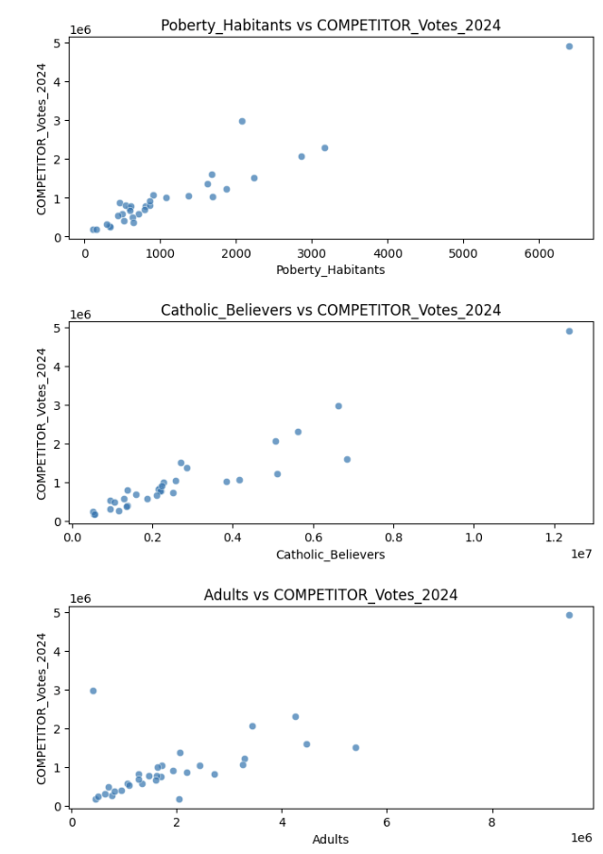
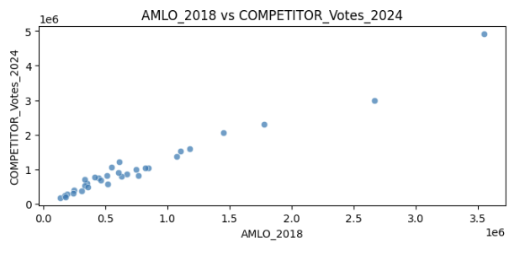
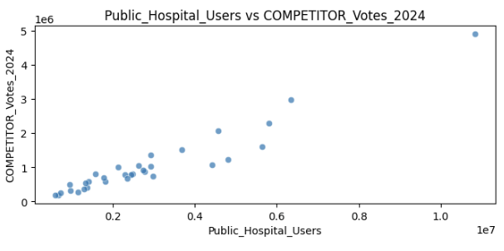
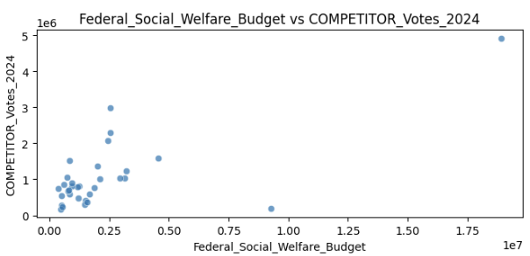
Linear Correlations
In General the votes for MORENA increase when these variables increase:
Poberty Habitants
Catholic Believers
Adults 40-50 yrs old
AMLO followers since 2018
Public Hospital Users
Federal Wellfare Budget

Slide 12
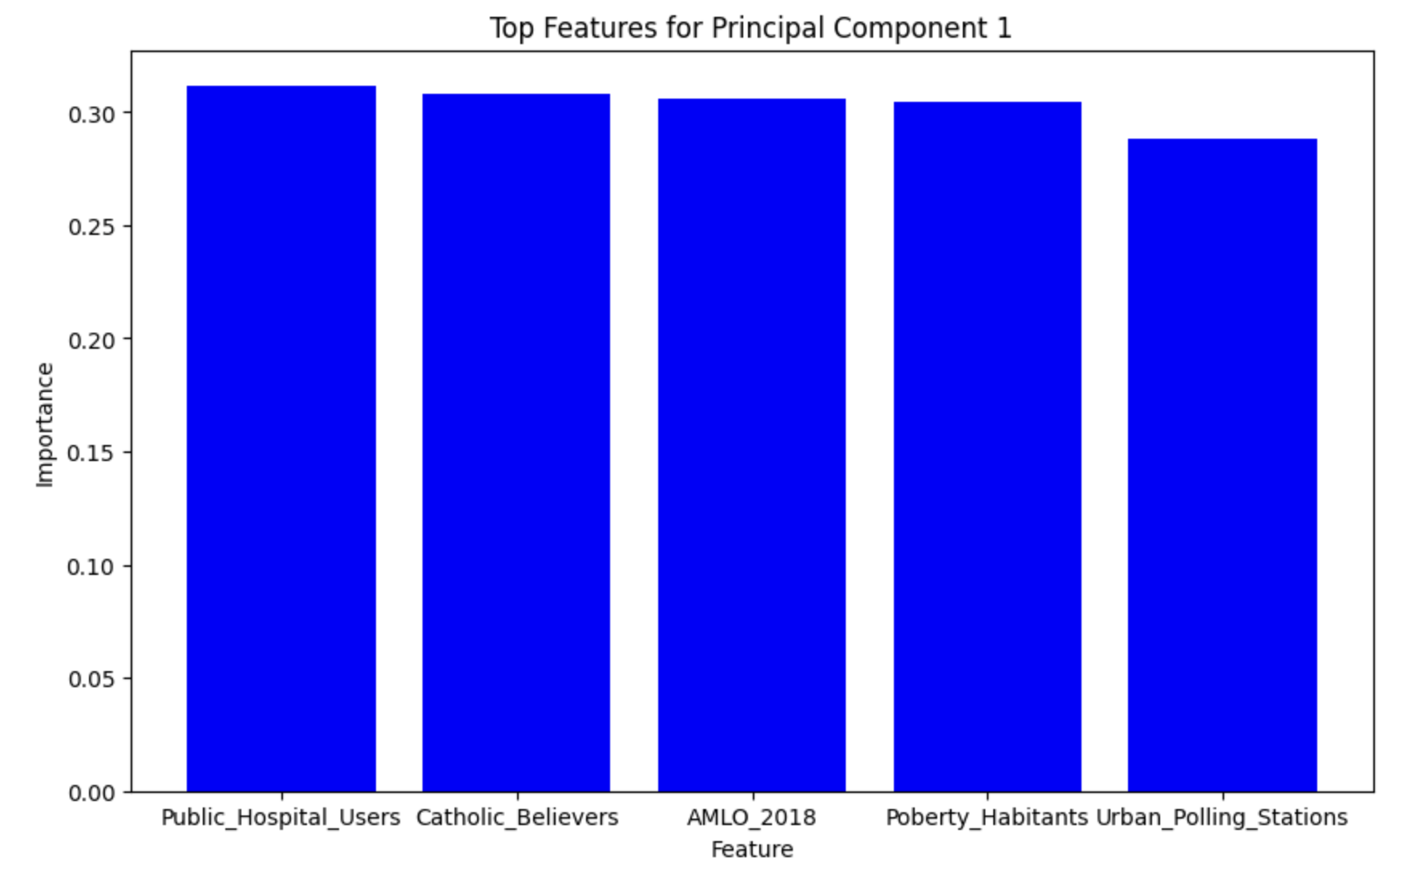
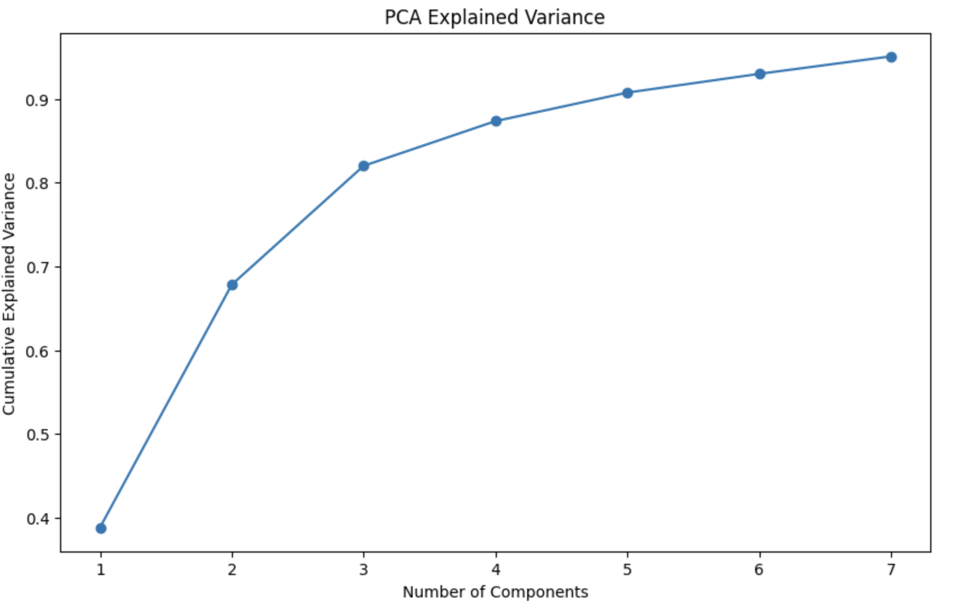
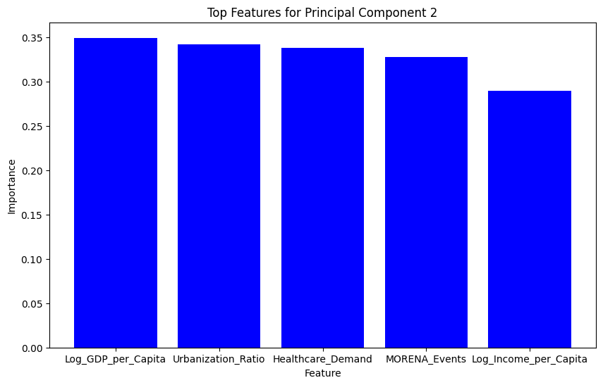
Clustering (PCA)
2 Componenets explain 67% of the Total Variation
3 Components explain 87% of Total Variation

Slide 13
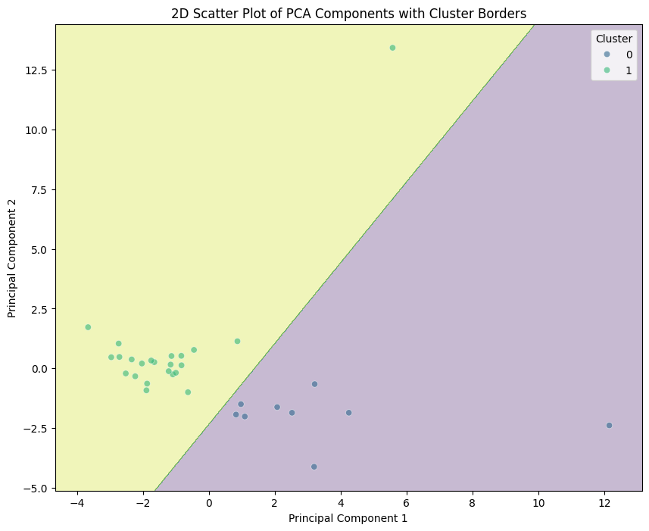
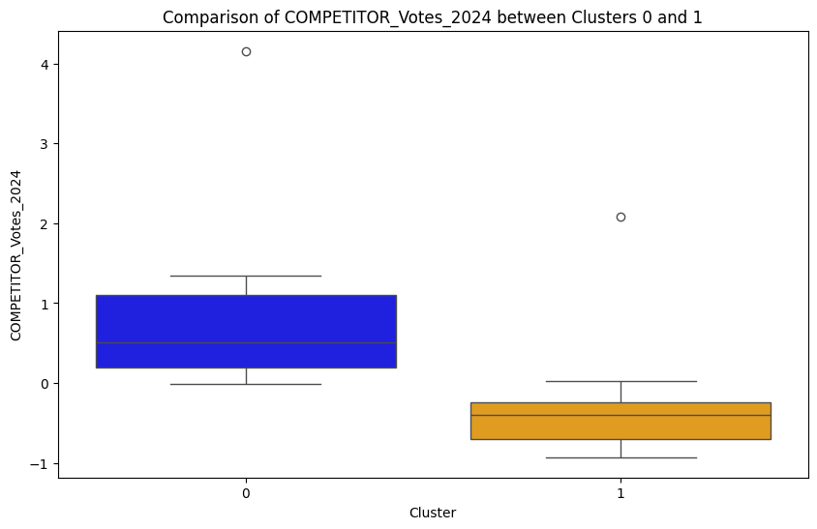
Clustering
Cluster #1 (PCA 1) has a lower voting preference for MORENA.
While has this features as key characteristics: High GDP, High Urbanization Ratio, Higher Healthcare demand and Higher Income per Capita.
Also is important to mention that in this cluster is where MORENA performed more campaing events!

Slide 14
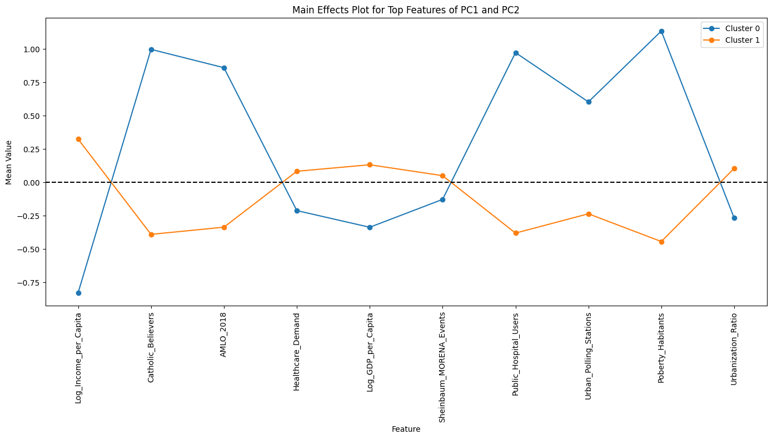
Behavior of the 2 clusters identified (Morena and Opposition)
Cluster #0 has a higher preference for MORENA while,
Cluster #1 (PCA 1) has a lower voting preference for MORENA.

Slide 15
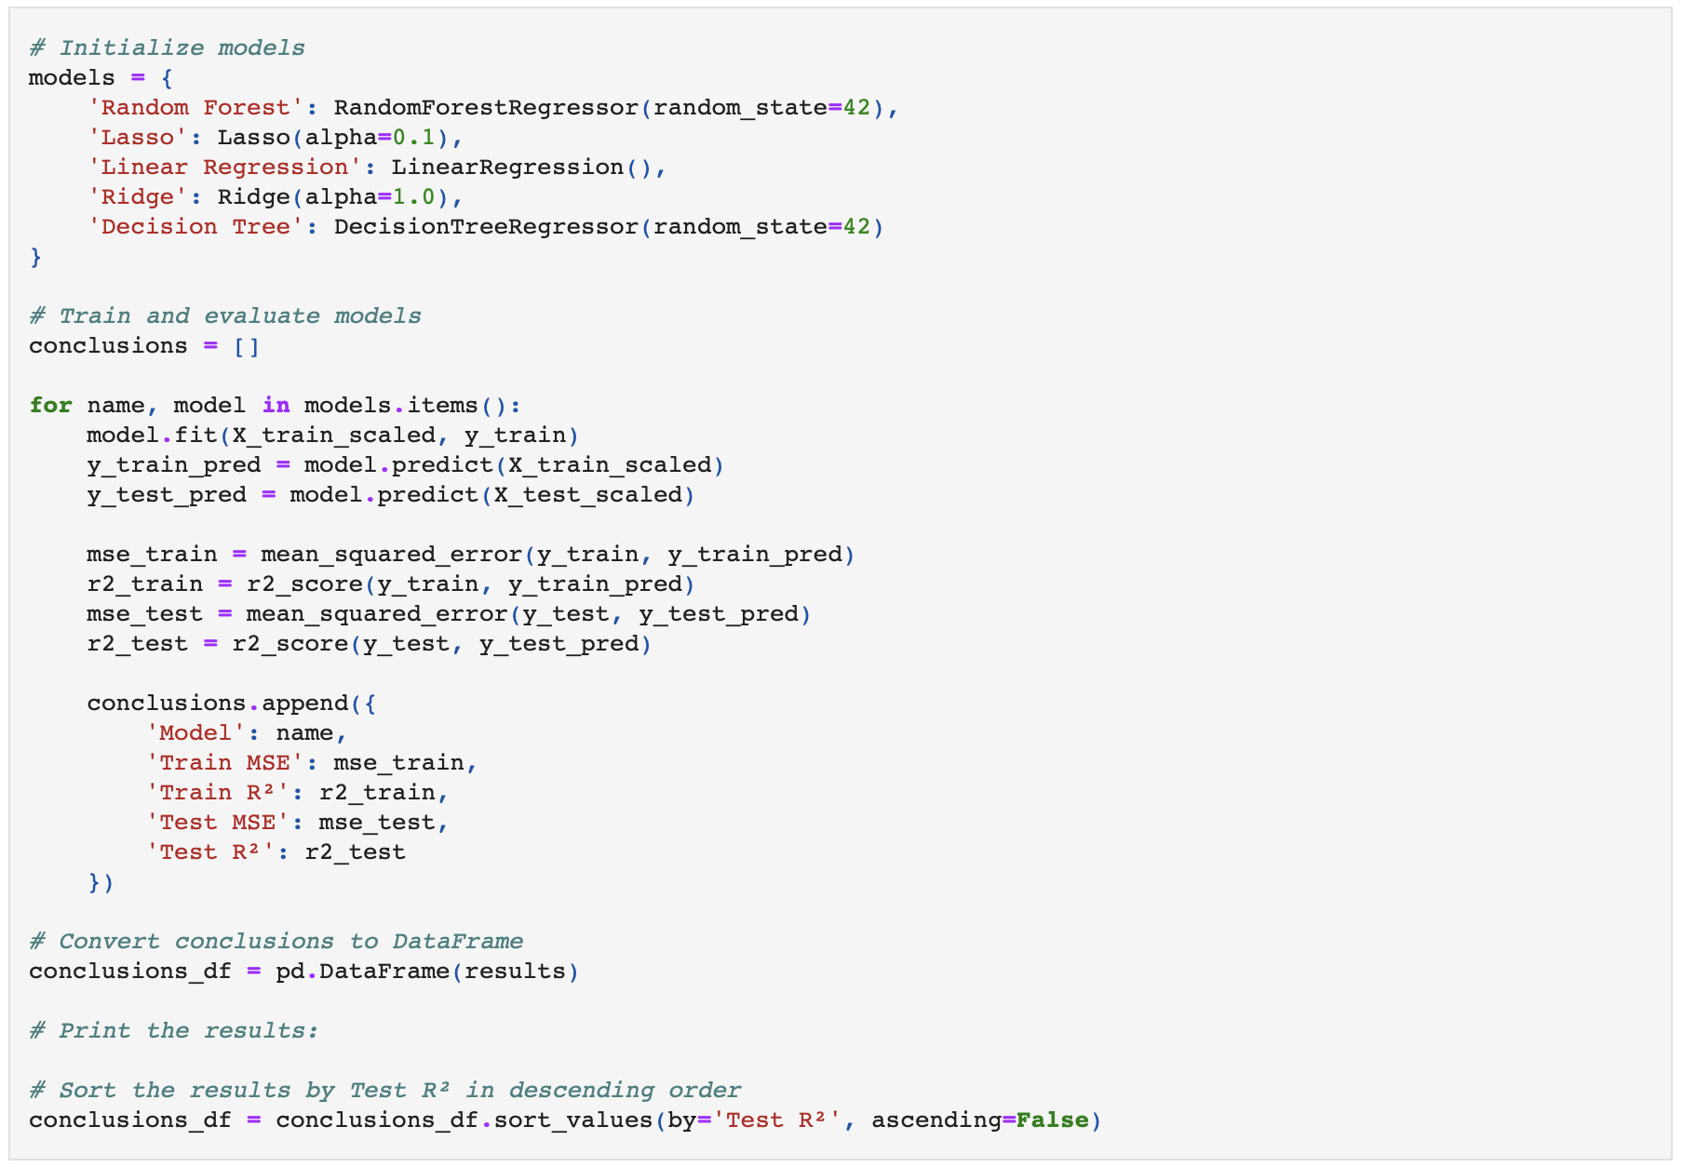
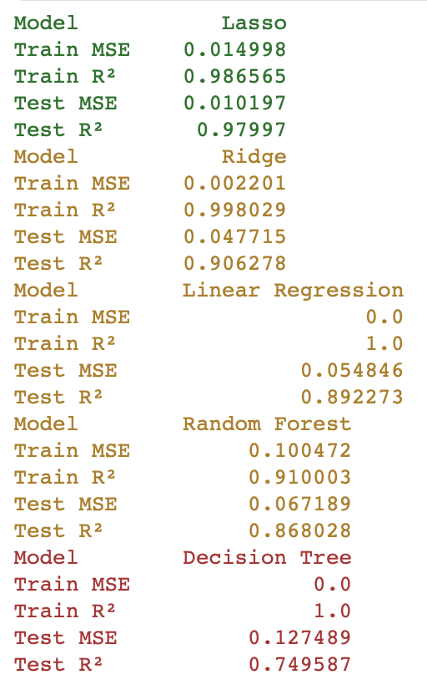
Modeling
5 Models where developed: Decission Tree, Random Forest, Linear Regression, Ridge and Lasso. The last model had the best performance (98% accuracy in testing and training)

Slide 16
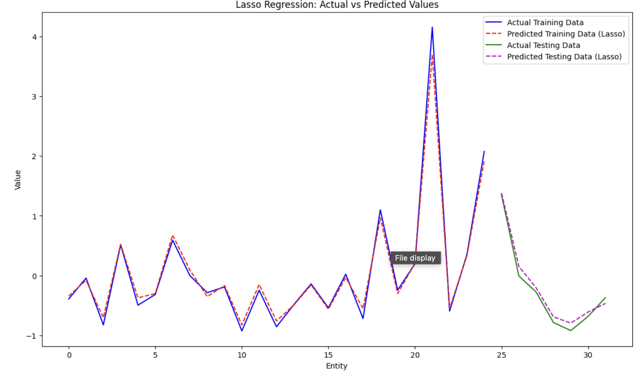
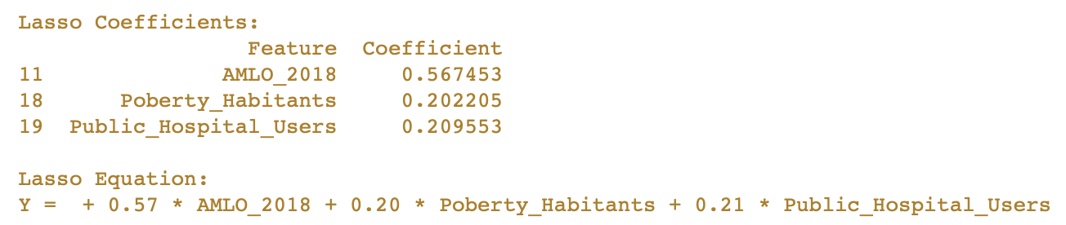
Results
Lasso Equation ML Model developed had a great performance that can be graphically seen in the above representation

Slide 17
Conclusion: Key Insights
Target Population: MORENA focuses on impoverished populations, which are their major voters. However, these voters do not necessarily contribute to GDP growth or industrial/economic development, presenting an opportunity for the opposition to highlight long-term benefits.
Campaign Efforts: MORENA held significantly more public events (617) compared to the opposition (223), despite spending 3x less on campaign budgets. The opposition should focus on engaging directly with impoverished populations rather than spending excessively on propaganda.
Key Demographics: The opposition should prioritize engaging with populations that have a strong preference for AMLO, federal welfare recipients, impoverished communities, Catholic believers, and adults.
Socioeconomic Clusters: There are two distinct clusters: one with a high socioeconomic profile (less likely to vote for MORENA) and another with a low socioeconomic profile (MORENA followers).
Political Polarization: AMLO has polarized these clusters with rhetoric of “Fifis vs Chairos.” This polarization should be addressed as all Mexicans are equal, and unity should be emphasized.
Future Projects: For future projects, incorporating demographic, economic, and social information per city could help create a more robust model that generalizes the data better.

Slide 18





Thank You!
https://www.linkedin.com/in/jjpo/
javierjorge77@gmail.com
https://github.com/javierjorge77/Springboard/tree/main/Capstones/Capstone2
(+521) 8711777903

